Slide 1

WheelGo
WheelGo, we all go!
— Project for NS Lehman Hackathon 2018
WheelGo.org

Slide 2

Mission Statement: Unlock the ability for everyone
Notes:
Julinda elaborates the motivation of WheelGo

Slide 3
The Problem
Percentage of people with disabilities
12.6%
People with disabilities have difficulty accessing everyday services.
Public space managers are not prepared to help those in need; therefore, assistance cannot be provided in a timely manner.
11.9%
2010 | 2013 | 2014 | 2015
Source: 2016 Disability Statistics Annual Report (https://disabilitycompendium.org/sites/default/files/user-uploads/2016_AnnualReport.pdf)

Slide 4
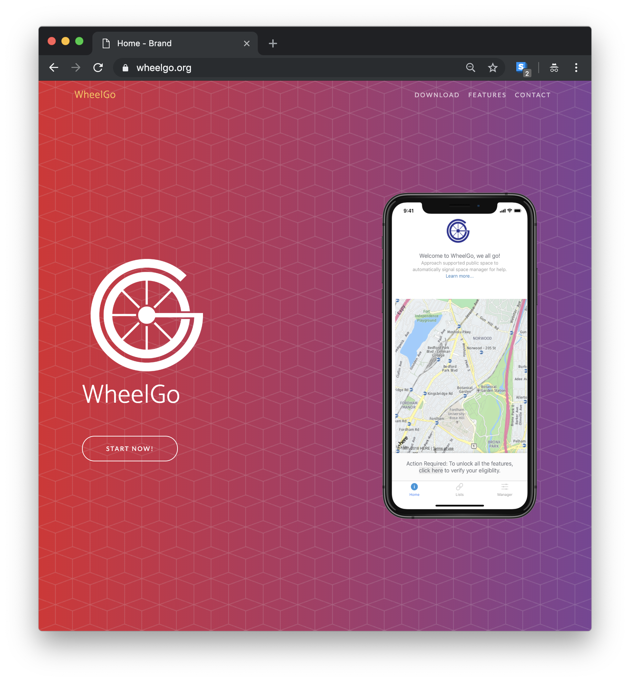

The solution
Create an app that allows communication between disabled persons and the space manager on-demand.
Time & effort saver!
Personalized services!

Slide 5




The Team
Four wheels that run the WheelGo!
JinWon Chung
Julinda Mujo
Ming Lei
Zifei Song
Computer Engineering & Studio Art City College Backend, Logo & Food Delivery
Maths & Physics Lehman College Chief Design Officer & Domain Manager
Computer Science Queens College Frontend & Creative Manager
Computer Science Queens College Researcher & Creative Assistant

Slide 6
Milestones
Show where we are in the process and what’s left to tackle
6:30 PM
7:00 AM
12:45 PM
Future
8:45 PM
8:48 AM
4:00 PM
Team founded
Frontend + Backend finalized
Showtime!
Conclude remaining features per request
November 16 |  |  |  | November 17 |  |  |  |  |  | Tomorrow +
Primitive brainstorming done
Project website access established
Award pick-up

Slide 7
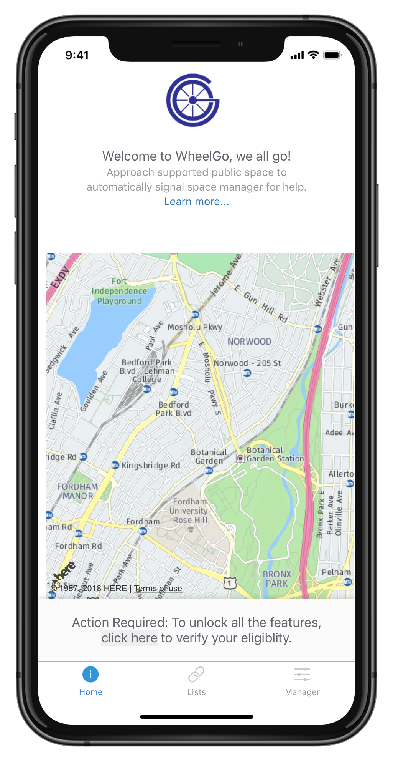
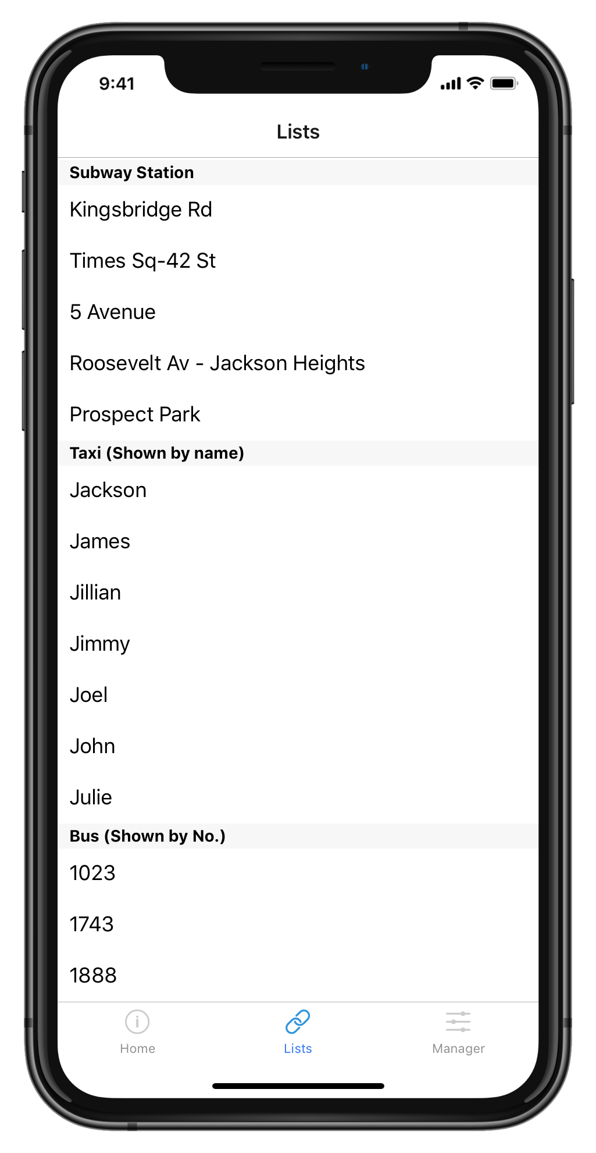

How It Works:
(for Persons With Disabilities)
Step 3
Step 1 Sign up as a disabled person.
You get assistance!
Step 2 Go to your favorite location as usual.

Slide 8
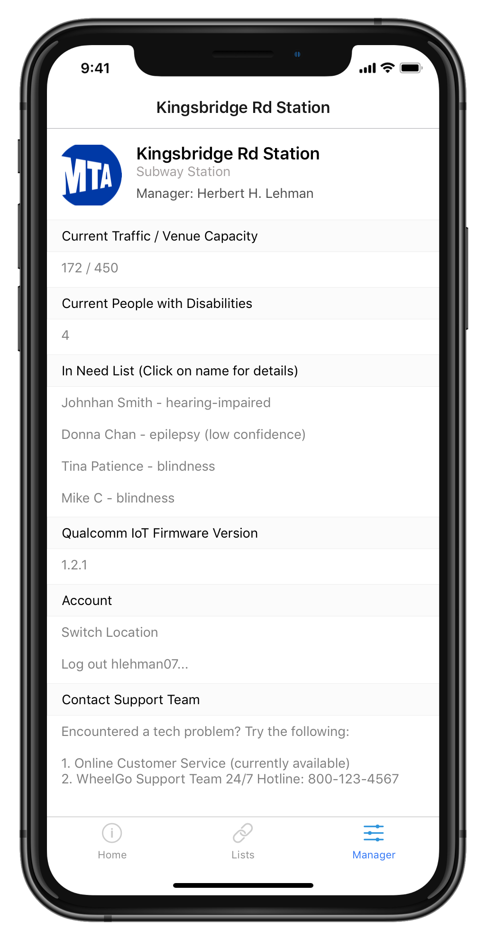
How It Works:
(for Public Space
Managers)
Step 1: Sign up in our app first.
Step 2: Get the notification about the arrival of the person.
Step 3: Help them!

Slide 9







Degree of Technical Difficulty:
One app for all platforms:
Data analysis + storage:
Aesthetic marketing design:

Slide 10


Thank you!
The WheelGo Team
https://wheelgo.org

